Slide 1


COLLEGE OF ENGINEERING AND MANAGEMENT, KOLAGHAT
Purba Medinipur – 721171 , West Bengal , India
EXAMSQAR
- A Smooth Remote Exam Conductor
A Project Work Submitted in fulfilment of the requirements for the Degree of
BACHELOR OF TECHNOLOGY in COMPUTER SCIENCE AND ENGINEERING
Prepared by : Sastik Kumar Das (Roll no : 10700120084)
Sayantika Khanra (Roll no : 10700120085)
Santu Jana (Roll no : 10700121127)
Under the Supervision of : Prof. Soumitra De

Slide 2

Table of Contents
Introduction
Design view
Objective
Flowchart
Scope
Design screen
Computerized vs Manual Examination system
Conclusion
Limitation
Technology Used

Slide 3


Introduction
Online Examination will reduce the huge work done by teachers, administrators.
Reduce paper work.
Result will be shown immediately that will reduce student anxiety.
Can be used anywhere anytime as it is a web based application.
Useful for teachers for managing exams.
It can be conduct any time.

Slide 4


Objective
Transition traditional, manual exam procedures to a fully digital platform.
Conduct exams effortless, utilizing comprehensive tools for exam management.
Reduce exam anxiety Amongst test takers.
Implement automated grading systems.
Promote social interaction between the test taker and experts.

Slide 5

Scope
Online Examination System is developed or designed for educational institutes.
Design to provide or facilitate Administrator and Student.
Complete and safe information is provided to user.
Can be used anywhere anytime as it is web based application.

Slide 6

Computerized vs Manual Examination system
Time saving
Increased efficiency
Allows neat handling of data rather than error prone records
Decreases overhead
Accurate

Slide 7


Technology used
We will employ a range of technologies to build this system:
For the frontend, we will use React.js. and Typescript
On the backend, we will implement Node.js and Express.js and Typescript.
Mongodb will serve as our database.
.

Slide 8

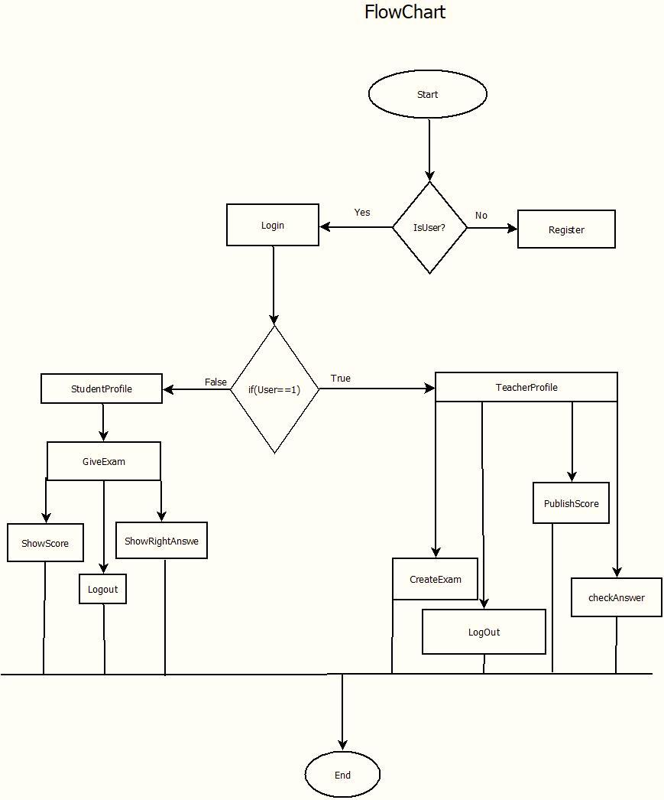
Design view
1. Flow Chart

Slide 9
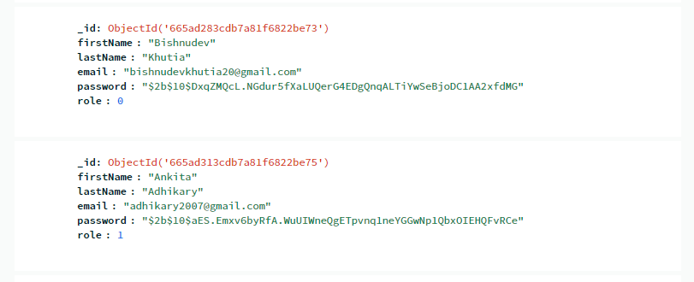
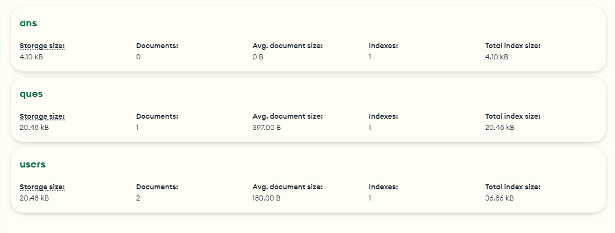
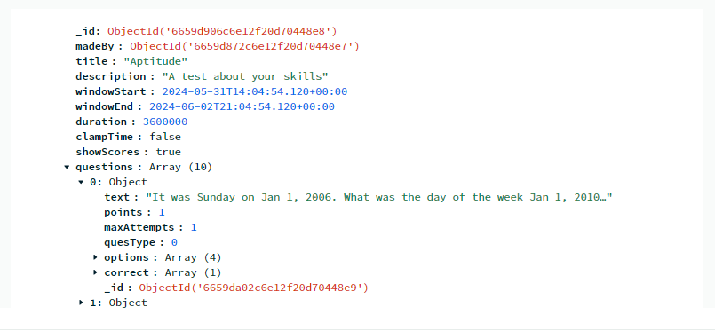
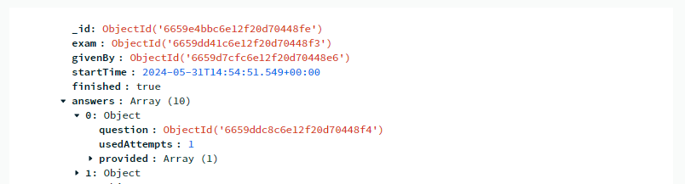
Design view
2. Data Base Design

Slide 10
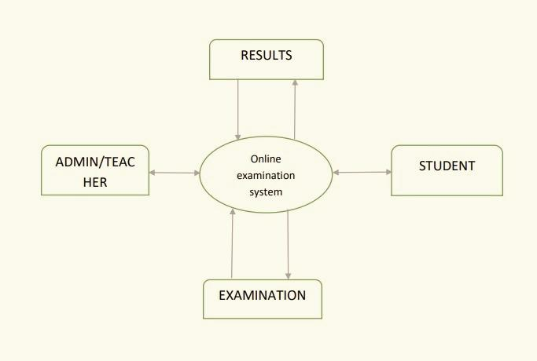
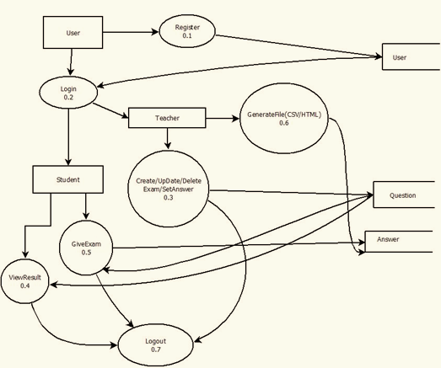
Data Flow Diagram
1. DFD - 0
1. DFD - 1

Slide 11
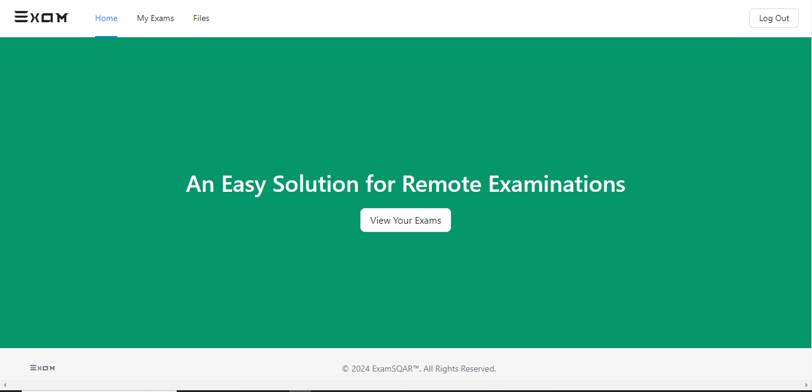
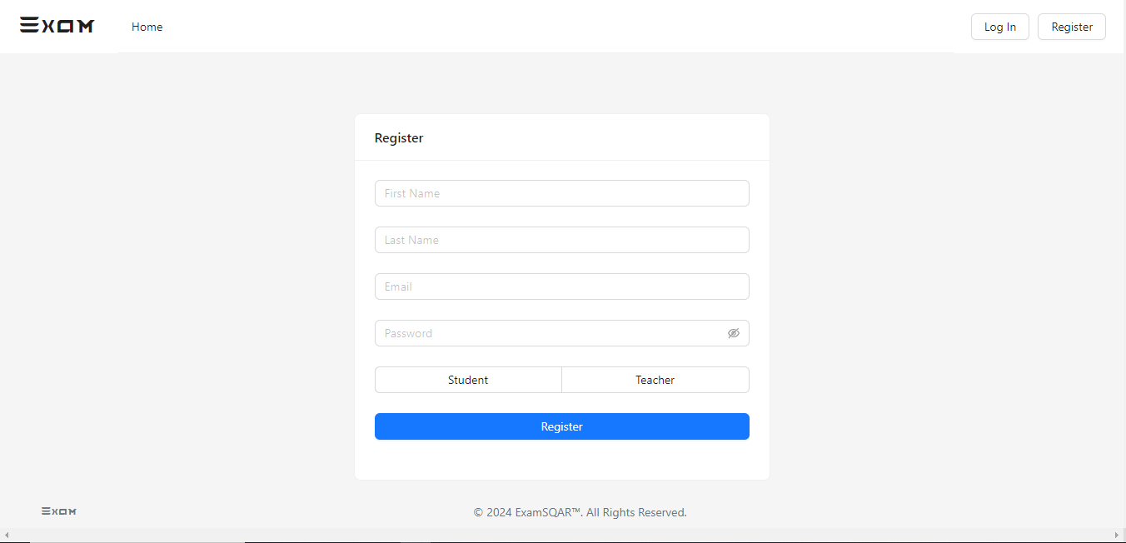

Design Screen
Home Page
Registration Page

Slide 12
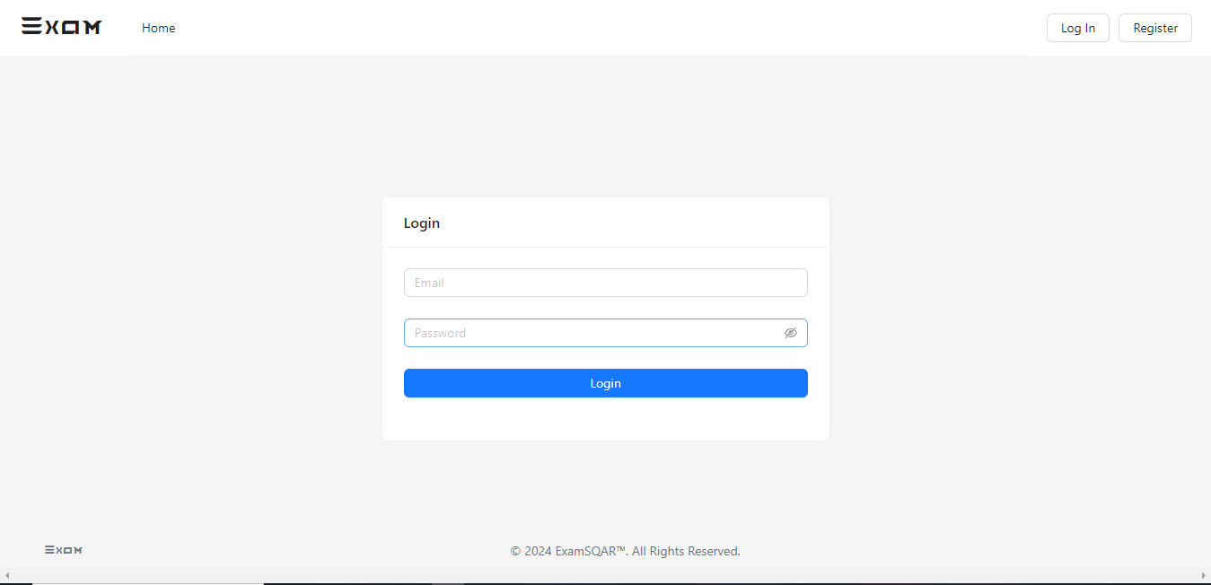
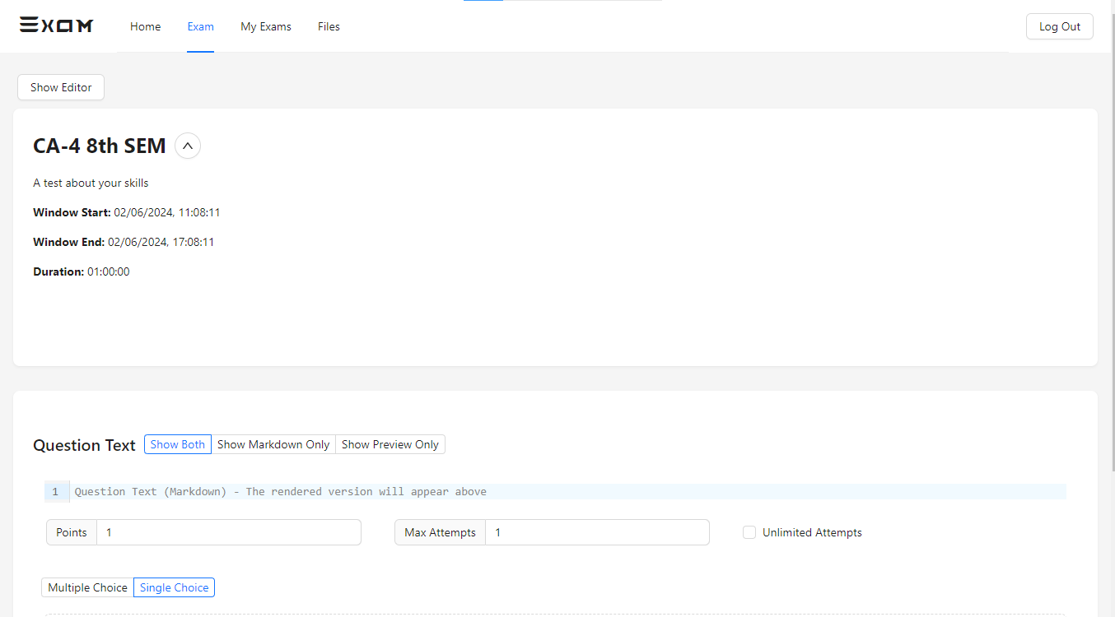
Design Screen
Login Page
Create Exam Page

Slide 13
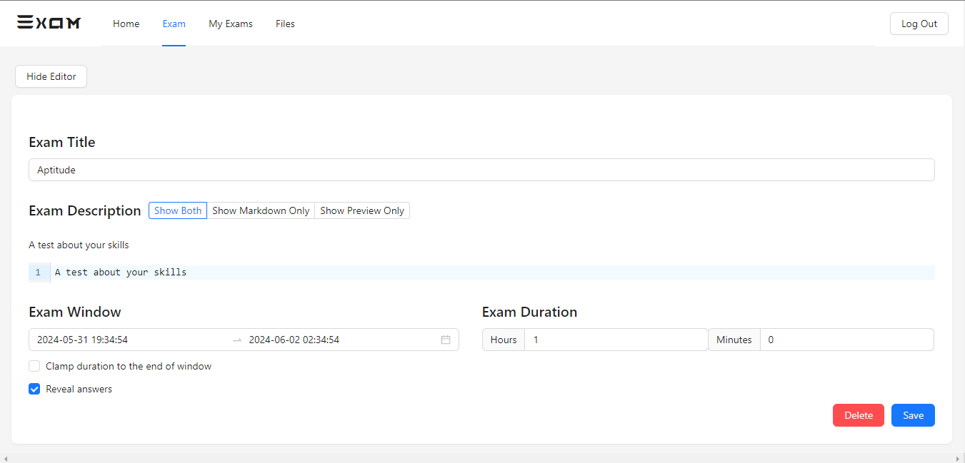
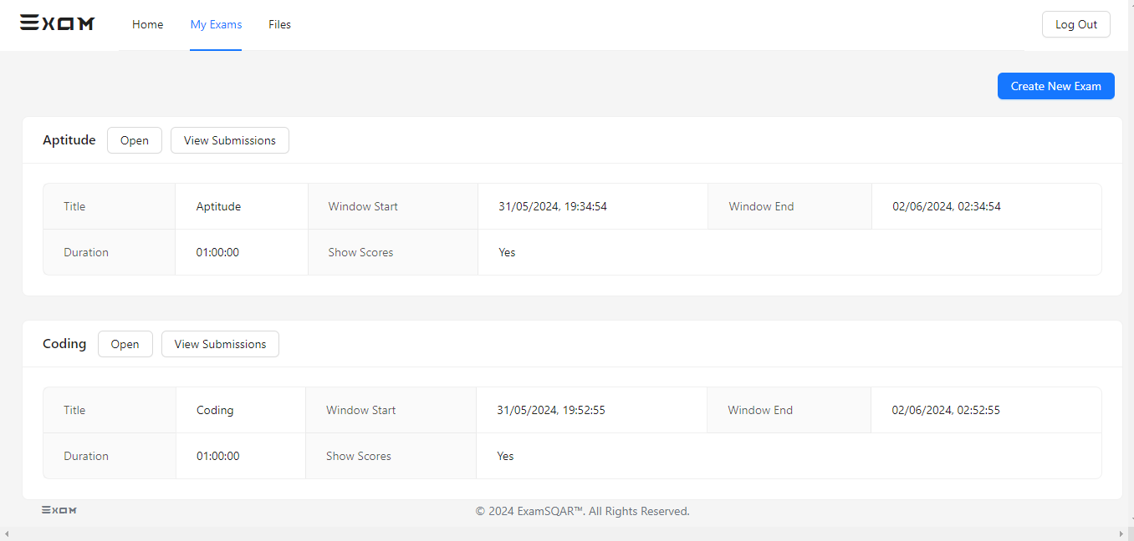
Design Screen
Update Page
Exam List Page

Slide 14
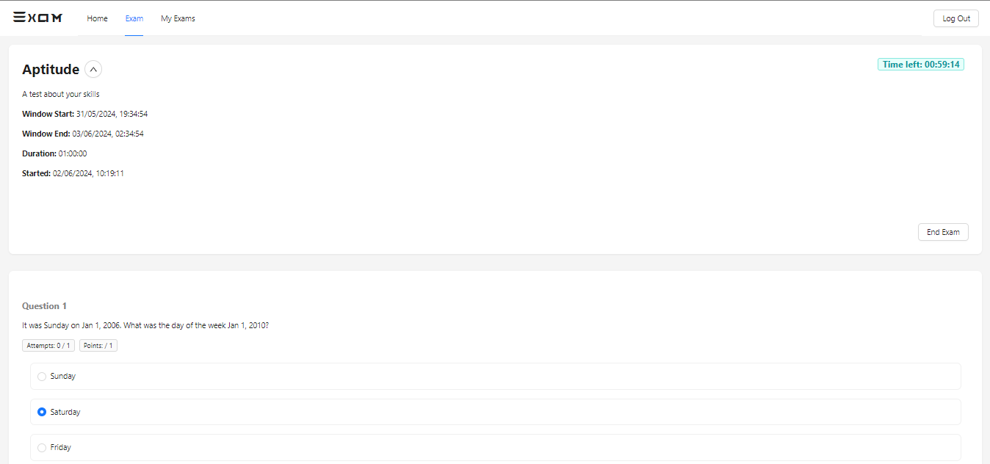
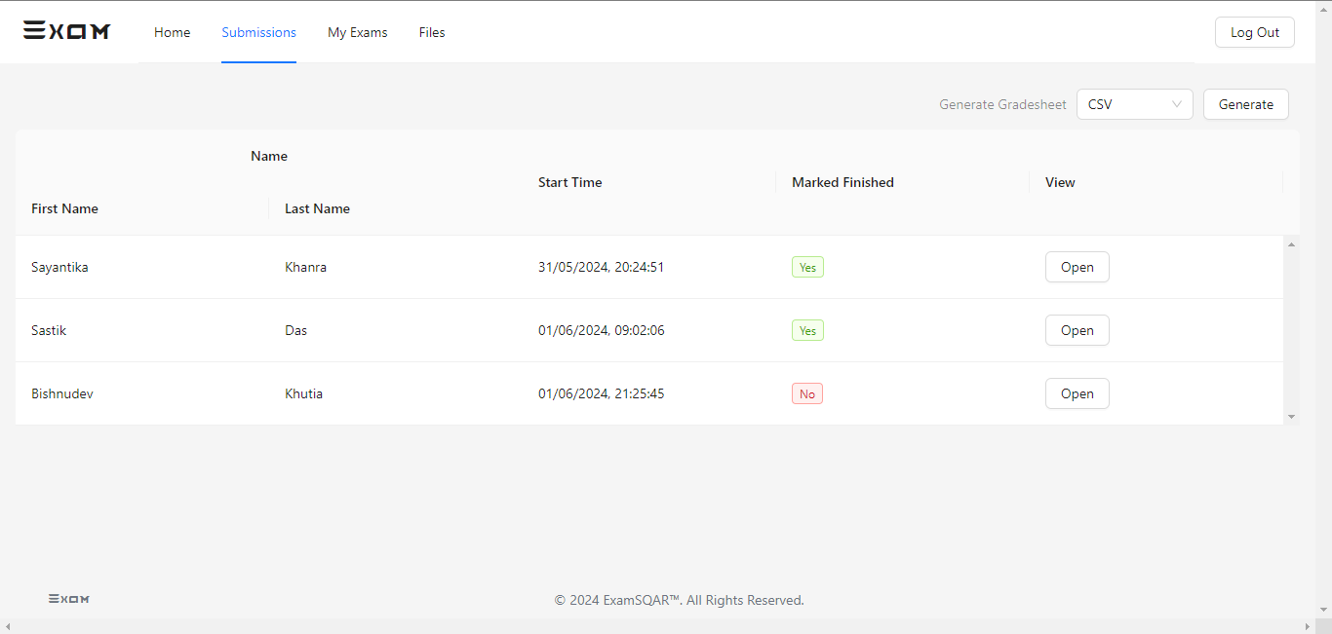
Design Screen
Exam Giving Page
Exam Submission Page

Slide 15
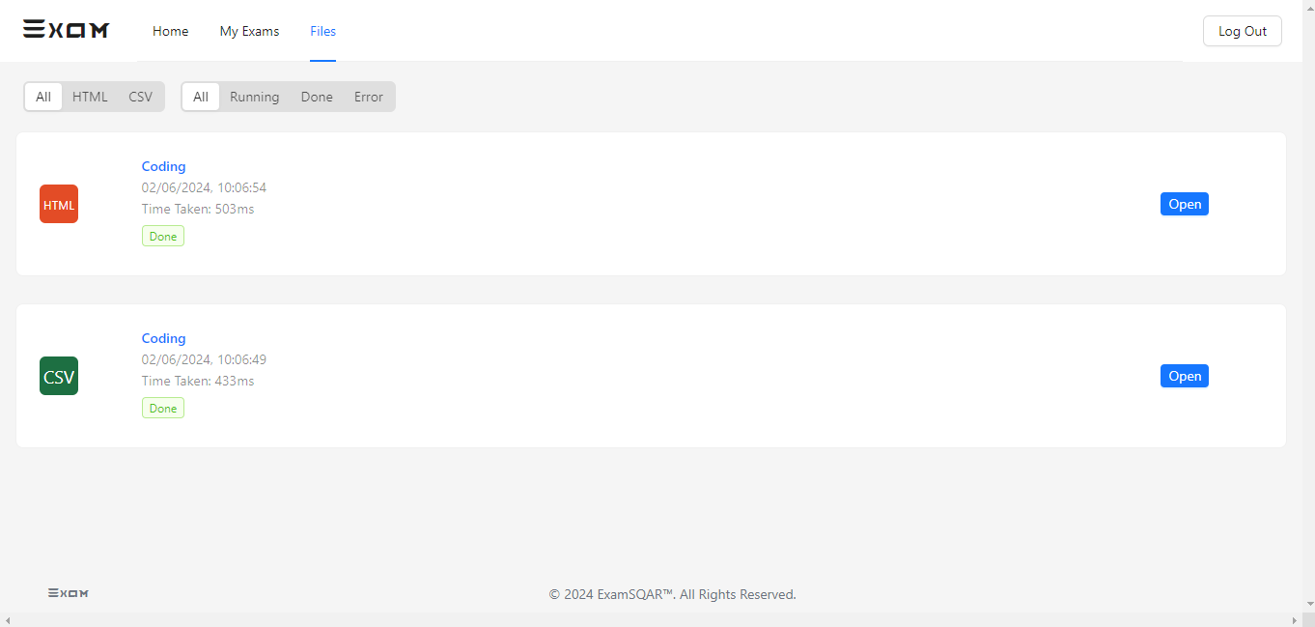
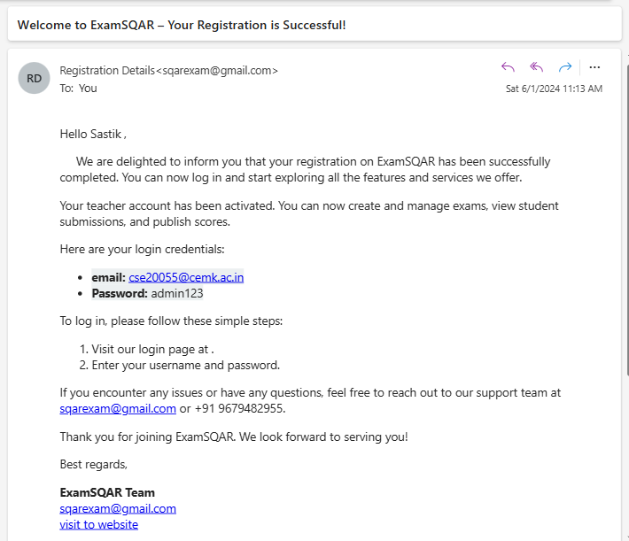
Design Screen
Generate Submission Page
Authentication Mail

Slide 16


Limitations
Current systems provides only multiple choices but single correct answer selection.
Incase questions and answers need to be in graphics, current system has no provision.
Unregistered users can only access the home page not any thing else.
No robust security features to restrict cheating during exams,.

Slide 17

Conclusion
This project modernizes exam procedures with a fully digital platform, enabling efficient creation, management, and grading of exams. It reduces student anxiety and promotes interaction with experts. Robust security features ensure exam integrity, while instant feedback and detailed reporting enhance transparency and effectiveness in educational assessment.

Slide 18







References
Books:
Examination Management System.
- International Journal of Advanced Research
Designing An Online Examination System With Object Detection-Based
- by Andini Setya Arianti
Websites:
Article on Online Examination System
Chapter on Online Proctoring Technologies
Definitive Guide to Online Exam Proctoring for Universities and Certification Providers

